Slide 1
Static Modeling
with UML
Lesson 3
CSCE 593 Intro to Software Engineering

Slide 2
Overview
The two faces of requirements
Requirements elicitation vs. analysis
Define structural relationships between classes
Associations
Composition / Aggregation
Generalization / Specialization
System Context Class Diagram
Depict external classes and system boundary
Static Modeling of Entity classes
Persistent classes that store data

Slide 3
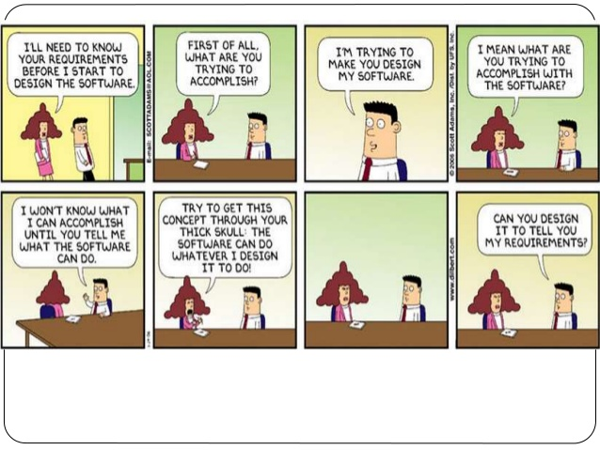

Slide 4
Req Elicitation & Analysis
The two faces of requirements:
Requirements elicitation: definition of the system in terms understood by the customer
Analysis: technical specification of the system in terms understood by the developer
Both focus on the user’s view of the system (only!)
Requirements elicitation uses natural language (e.g. use cases, scenarios, stories)
Requirements analysis model uses specialized notation (e.g. UML: class (static) and sequence diagrams (dynamic))
Elicitation & analysis occur concurrently & iteratively

Slide 5
Question
Why create a domain model?
Because we can
Because it’s part of every life cycle process

Slide 6
Question
Why create a domain model?
Create a bridge between domain-language requirements and design
Guide discussion/thought processes
Clarify

Slide 7
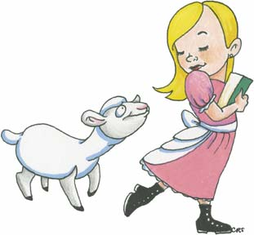
Clarify?
“Mary had a little lamb”
Schoolgirl
owns ►
Lamb

Slide 8
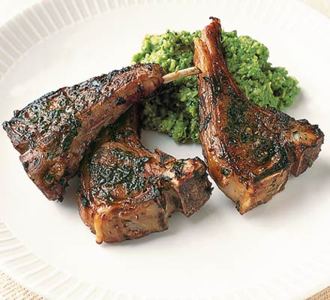
Clarify?
“Mary had a little lamb”
Diner
eats ►
Lambchops

Slide 9
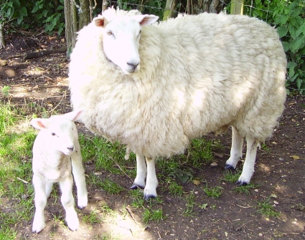
Clarify?
“Mary had a little lamb”
Ewe
gives birth ►
Lamb

Slide 10
Object Oriented Premise
The basic premise behind object oriented design is that we can model software and other systems as
Collections of Collaborating Objects

Slide 11
Object Oriented Premise
Class: A set of related data & operations on that data
Object: Instantiation of a class
C++:
auto myPtr = std::make_unique< MyClass >();
std::unique_ptr< MyClass > myPtr = std::unique_ptr< MyClass >( new MyClass{} );
MyClass* myPtr = new MyClass{};
MyClass m{};

Slide 12
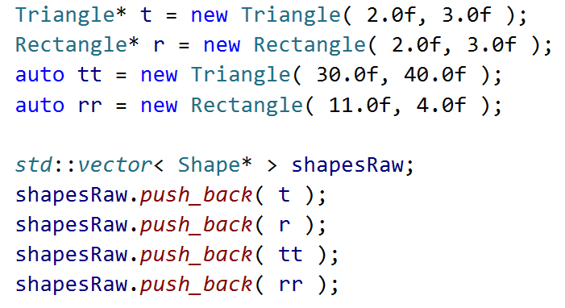
C++ - Creation of Objects on Heap (Manual Allocation)

Slide 13
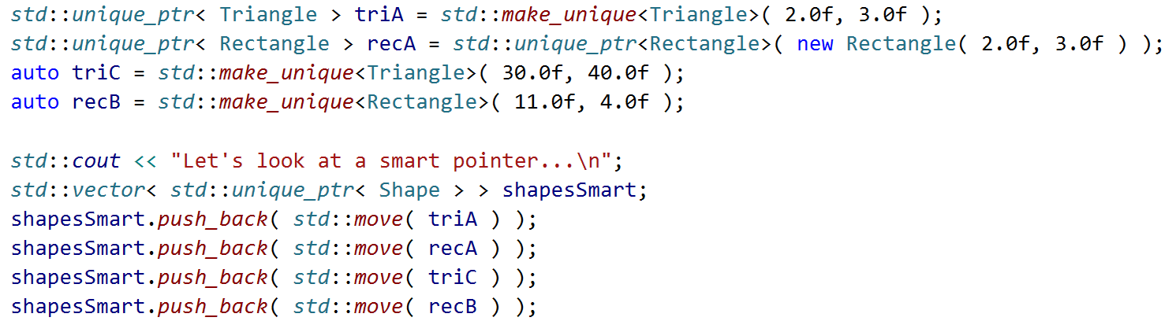
C++ - Creation of Objects on Heap (RAII – Modern)

Slide 14
C++
For working example, see: “git593/Lectures/03LecInherit.cpp“ “git593/Lectures/03LecInherit.h“

Slide 15
UML Notation for Objects
Objects model things (entities) in the real world
object name
class name
name compartment
jimsAccount : Account
number = “987-654-3210”
owner = “Jim Stewart”
balance = $300.00
attribute compartment
attribute name
attribute value

Slide 16
UML Notation for Classes
Classes model kinds of things (i.e. a set of potential things)
name compartment
Account
number
owner
balance
attribute compartment
deposit()
withdraw()
operation compartment

Slide 17
Attributes
Attributes describe objects
Size, shape, color, etc.
Attributes are defined by
A name
A type
A value
The type defines legal values for the attribute
The type is often a string or a number
Complex types include dates, addresses, currency
Modeled as classes & called datatypes
Instances of a data type are called value objects

Slide 18
Associations
Association is
Physical or logical relationship between classes (e.g. Employee works in Department)
Shown as solid lines between two classes
Specifies how many instances of one class may relate to a single instance of another class
Employee
works in ►
Department
employeeName
employeeId
employeeAddress
deptmentName
deptmentLocation

Slide 19
Associations
One-to-one
One-to-many
Company
Bank
name: String
address: String
businessSector: String
name: String
bankAddress: String
1
1
Is led by ▼
Maintains ▼
1
1..*
CEO
Account
name: String
employeeId: String
address: String
phoneNumber: Integer
accountNumber: Integer
balance: Real

Slide 20
Associations
Numerically specified
Optional (zero to one)
Car
Customer
modelName: String
manufacture: String
modelYear: Date
name: String
id: String
address: String
1
1
Has ▼
Owns ▼
2,4
0..1
Door
DebitCard
height: Real
width: Real
windowArea: Real
material: String
cardId: Integer
pin: String
expirationDate: Date
balance: Real

Slide 21
Associations
Optional (zero, one, or many)
Many-to-many
Customer
Course
name: String
id: String
address: String
id: String
name: String
section#: Integer
semester: String
1
0..*
1
Owns ▼
▲ Enrolls in
Attended by ▼
0..*
CreditCard
0..*
cardId: Integer
cardType: String
expirationDate: Date
limit: Real
Student
name: String
id: String
address: String

Slide 22
Association Class
Class to model association between two or more classes
Usually for many-to-many associations
Association attributes not a part of either Class
Example: Project and Employee classes
Employee
works on ►
*
Project
*
◄ has
name: String
id: String
address: String
id: String
name: String
start: Date
end: Date
customer: String
Hours
hoursWorked: Real

Slide 23
Composition / Aggregation
Whole/Part Relationships
Show parts of more complex class
Composition is stronger relationship than aggregation
IS PART OF relationship
Associates part classes with the whole class
Composition is stronger relationship than aggregation

Slide 24
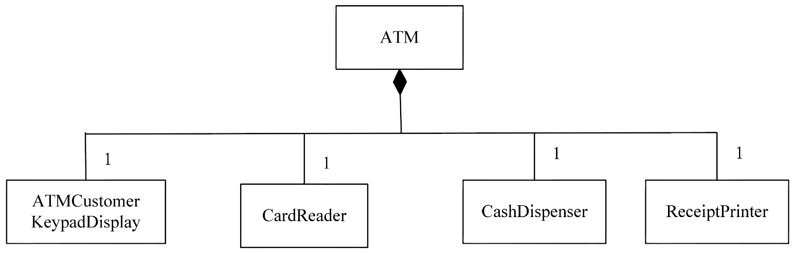
Composition Hierarchy
Composition Hierarchy
Whole and part objects are created, live, die together
Often also has a physical association
Association between instances
ATM Example:

Slide 25
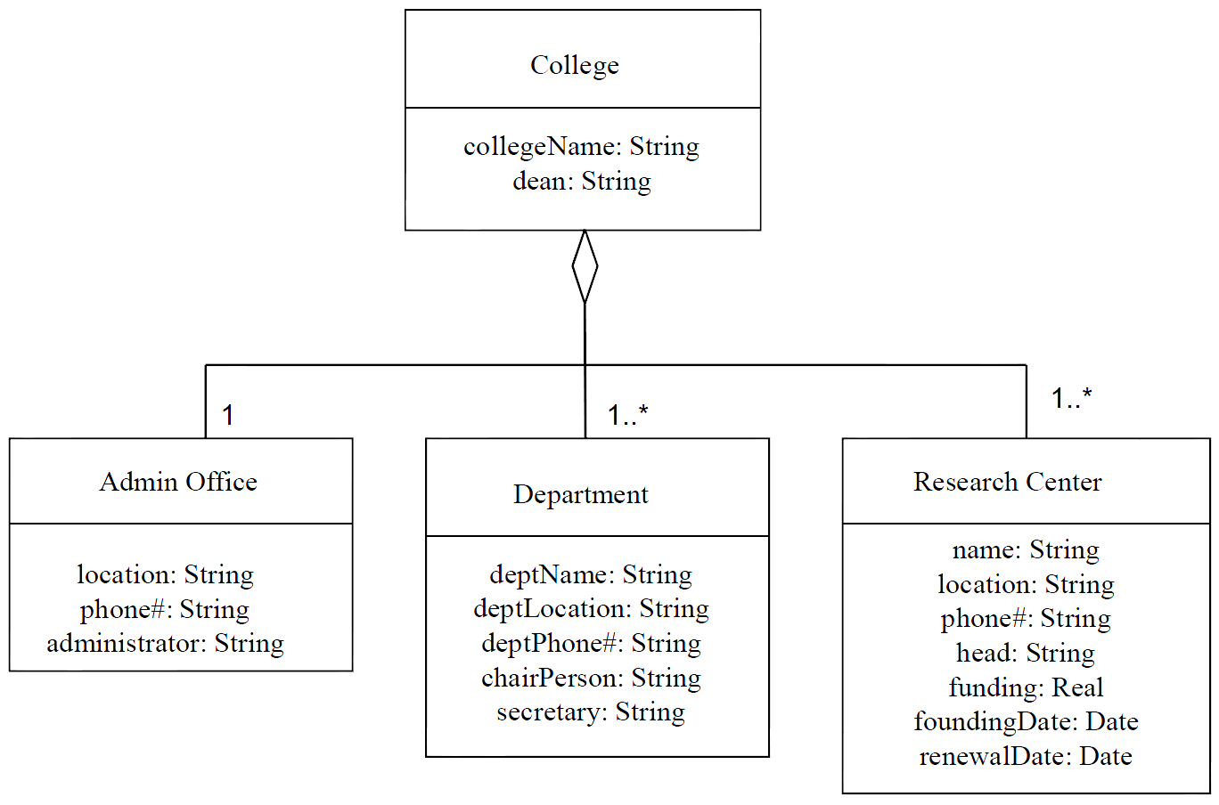
Aggregation Hierarchy
Aggregation Hierarchy
Part objects may be created and deleted independent of the aggregate object

Slide 26
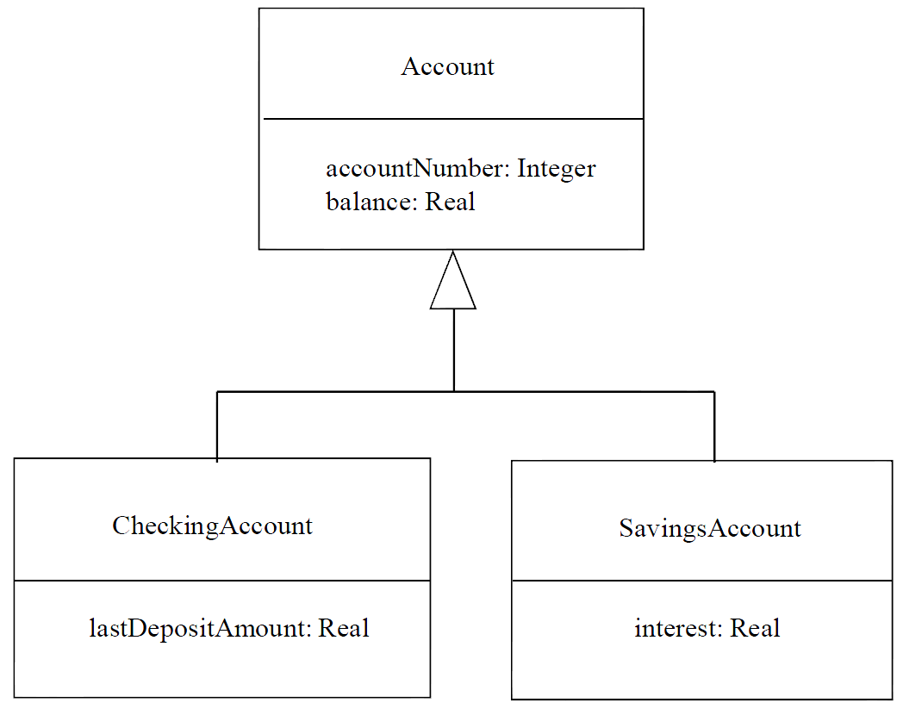
Generalization / Specialization
IS A relationship between subclass and superclass
Some classes are similar but not identical
Have some attributes in common, others different
Abstract common attributes into generalized class (i.e. superclass)

Slide 27
Creating a Domain Model
Find the conceptual classes (entities)
Reuse or modify existing models
Use a list of common categories
Examine noun phrases in the use cases
Draw a class diagram
Give each class a symbol (a name)
Define each class (intention) in the glossary (data dictionary)
Optionally, explore examples with an object diagram (extension)

Slide 28
Creating a Domain Model
Add associations
What links between objects do we need to remember?
Use a list of common associations
Examine verbs, prepositions and possessives in use cases
Update glossary (data dictionary)
Optionally, explore variations with object diagrams
Add attributes & Operations
What information (Attributes) about objects do we need to remember (nouns)?
Examine verbs (Operations), prepositions and possessives in use cases
Update glossary (data dictionary)
Define data types as needed

